Slide 1
Capstone Project – Places to eat at while in Australia

Slide 2
Contents
Introduction
Data
Methodology
Results
Discussion
Conclusion

Slide 3
Introduction
Last year over 9 million tourists travelled to Australia to experience the different sights, sounds and cultures that it has to offer. While these people are here, they want to try the various foods that the country has, but they won't want to eat at places that serve low quality food.
This project will aim to provide these tourists with a visualisation of the top-rated food outlets in the 5 major cities of Australia. This will include finding the top-rated restaurants within a certain distance from the reference point. To make it more convenient and easier for travellers access these places, the reference point in each city will be the city’s main train station.

Slide 4
Data
Foursquare API will be used to collect the ratings of food outlets and restaurants within a certain radius of the 5 reference points in the major cities of Australia: Sydney, Melbourne, Brisbane, Perth and Adelaide.
The amount of venues in each city will be limited to 50 as that is the maximum that Foursquare can provide to a user. This data will then be refined to only include places with a rating.

Slide 5
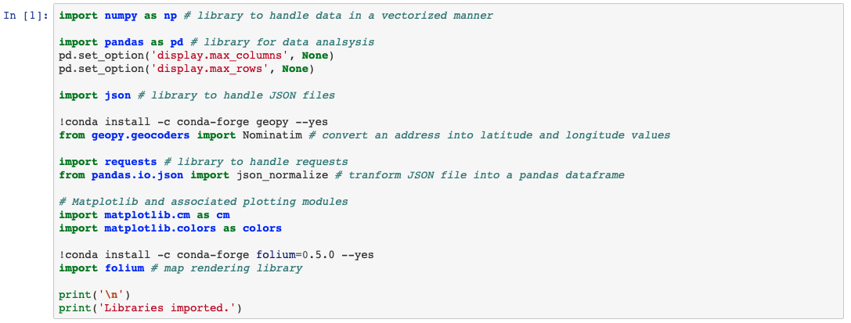
Methodology Step 1
Load in required libraries and Foursquare API credentials so that the data can accessed.

Slide 6
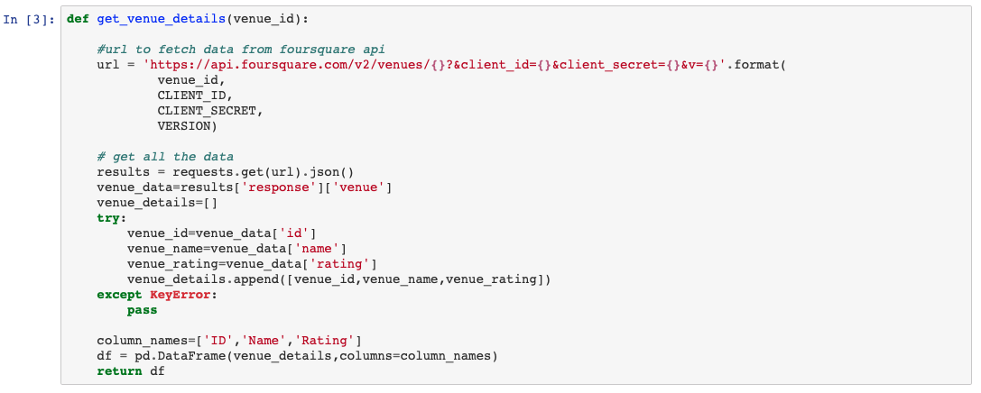
Methodology Step 2
Create a function that allows us to access various venue details for a given venue id and place it into a table if it has a rating.

Slide 7
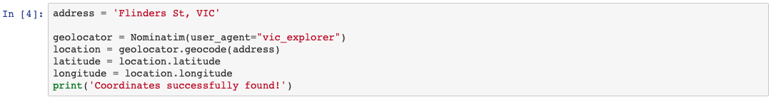
Methodology Step 3
Access the coordinates of a certain address in the given city.

Slide 8
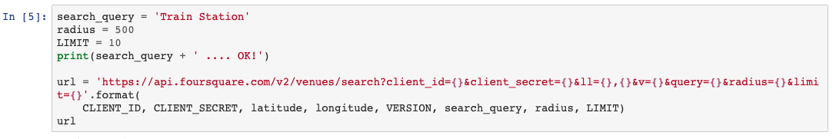
Methodology Step 4
A search query is used to find the train station within 500 metres of the given address. The search is limited to 10 results.
The corresponding URL is then defined.
The GET request is used on all URL’s to collect the information from Foursquare API.

Slide 9
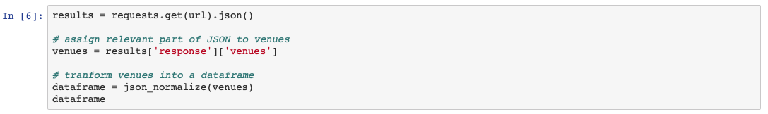
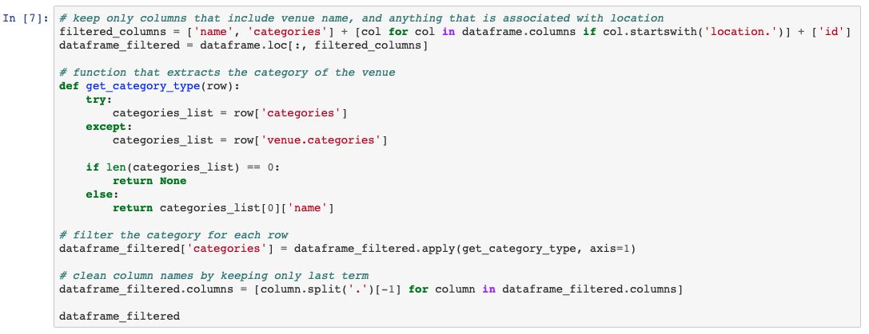
Methodology Step 5
After using the GET request, the information is then transformed into a pandas data frame.
The data frame is then filtered to only include the required details in an easy to read format.

Slide 10
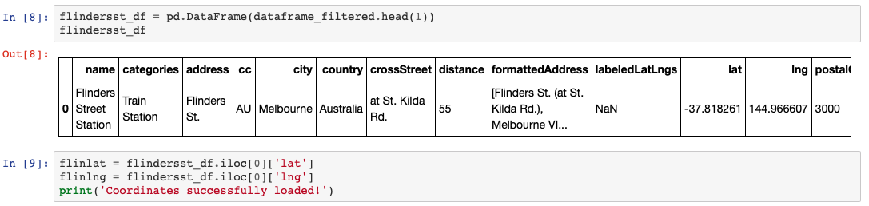
Methodology Step 6
The next step was to access the exact coordinates of the train station.
The search query is now used to find restaurants within 500 metres of the train station. The search is limited to 50 results. This limit is the maximum set by Foursquare.

Slide 11
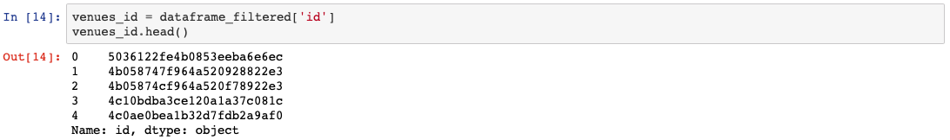
Methodology Step 7
Repeat steps 4 & 5 to create a data frame that lists the restaurants, their location details and their proximity to the train station.
A data frame is then created that contains the venue id’s of all the restaurants found.

Slide 12
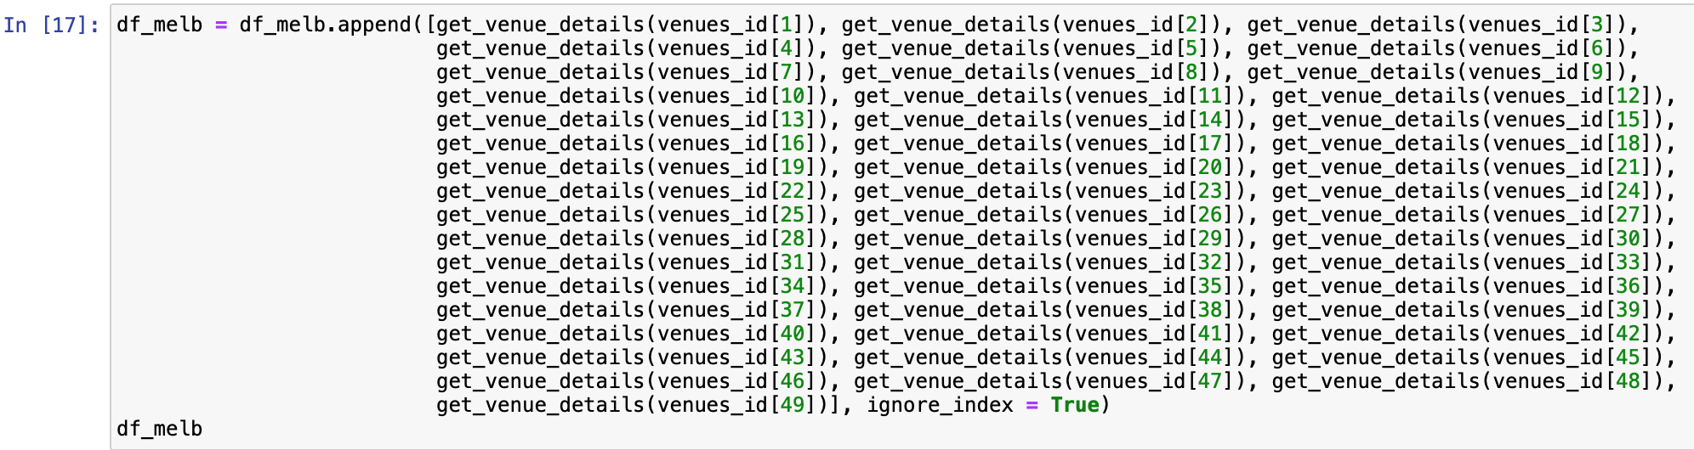
Methodology Step 8
The penultimate step is to construct a data frame that shows the restaurant with its rating. If a restaurant didn’t have a rating, the defined function would not include that restaurant in the data frame.

Slide 13

Methodology Step 9
A set of summary statistics is then produced.
These steps are used on all five cities.
For a detailed explanation of the code used visit the following notebook: https://github.com/ben96w/Coursera_Capstone/blob/master/Coursera_Capstone_The_Battle_of_Neighborhoods.ipynb

Slide 14
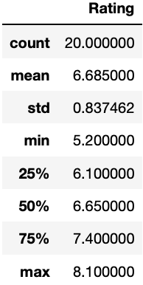
Results - Melbourne
Foursquare API was able to obtain 50 restaurants from its search of the area around Flinders St Station.
Table 1 shows that there were 20 restaurants out of the 50 that contained a rating.
The average rating of these restaurants is 6.685.
Table 1

Slide 15
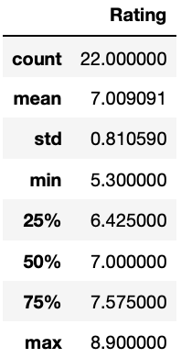
Results - Sydney
In Sydney, Foursquare API was able to find 41 restaurants around Central Station.
It is shown in Table 2 that 22 of these restaurants had a rating.
These restaurants had an average rating of 7.009.
50 percent of these restaurants have a rating greater than or equal to 7.
Table 2

Slide 16

Results - Brisbane
In Brisbane, Foursquare API was only able to find 8 restaurants within the given radius around Roma St Station.
Out of the 8 restaurants, only 1 had a rating.
This was Bishamon Japanese Restaurant with a rating of 8.4.

Slide 17
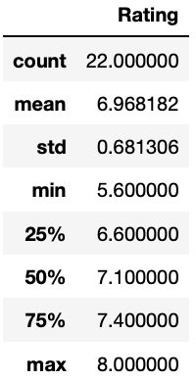
Results - Perth
The Foursquare API URL was able to find 50 restaurants around Perth Station with 22 of these 50 restaurants having a rating.
The average rating of these restaurants is 6.96.
Perth restaurants had a standard deviation of 0.681 meaning that most restaurants had a rating between approximately 6.3 and 7.6.
Table 3

Slide 18
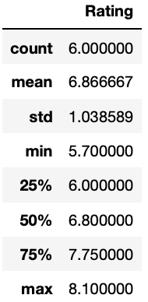
Results - Adelaide
Foursquare API found 17 restaurants around the Adelaide Station. Within these 17 restaurants, only 6 of them contained a rating.
The average rating of these 6 restaurants is 6.867.
Table 4

Slide 19
Discussion
Sydney had the greatest percentage of rated venues at 53.66 % and the highest average rating of the five cities.
The ratings of Perth’s restaurants had the lowest standard deviation of the five cities while Adelaide had the largest.
Sydney had the highest rated restaurant at 8.9 while Melbourne had the lowest at 5.2.
Melbourne had the lowest average rating.
Brisbane had only 1 restaurant that was rated out of the 8 selected.
Adelaide had the lowest 25th percentile but had the highest 75th percentile.

Slide 20
Conclusion
This project utilized Foursquare API to collect information on restaurants in the five major cities of Australia.
It was found that Sydney was the best place for a person to visit for highly rated food.
Comparisons between the cities could be improved if the radius was adjusted in each city to allow Foursquare to obtain the same number of restaurants for each location.
Different results could also be obtained by changing the radius to a larger distance if the visitor would like to travel further away.

